Slide 1
Chain of Responsibility Pattern
The chain of responsibility pattern allows a request sent by a client to be received by more than one object. It creates a chain of loosely coupled objects that, upon receiving the request, either handle it or pass it to the next handler object.
This pattern is essentially a linear search for an object that can handle a particular request.
A common example of this pattern is event bubbling in DOM.
@ShankaragoudaG

Slide 2
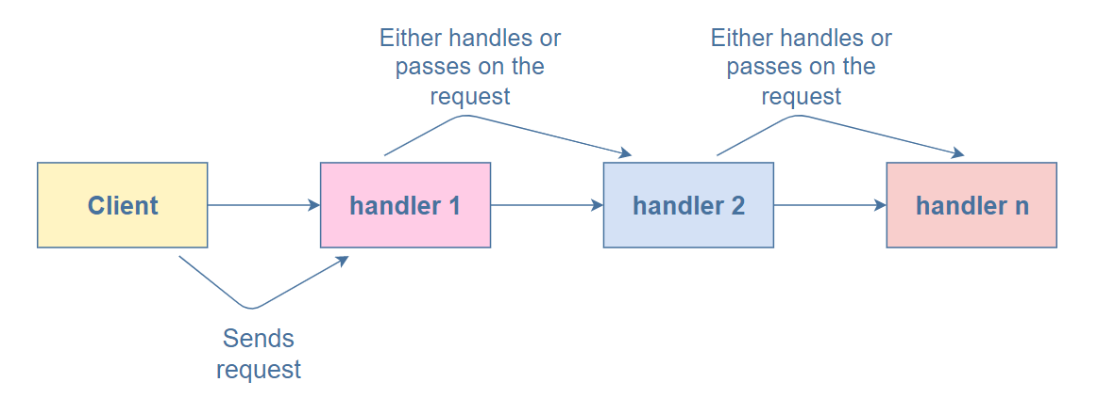
Chain of Responsibility Pattern
An event propagates through different nested elements of the DOM until one of them handles it.

Slide 3
Participants
Client :
initiates the request to a chain of handler objects
Handler:
defines an interface for handling the requests
implements the successor link (returning 'this')

Slide 4
Example
An example of a chain-of-responsibility is event-bubbling in which an event propagates through a series of nested controls one of which may choose to handle the event.
The Chain of Responsiblity patterns is related to the Chaining Pattern which is frequently used in JavaScript (jQuery makes extensive use of this pattern).

Slide 5
Continued..
The next slide example implements the chain of responsibility pattern to check if a given number is a multiple of two, three, or five.
chain decide if they’re going to process it or pass it to the next.
MultipleofTwoHandler: checks if the number is a multiple of two.
MultipleofThreeHandler: checks if the number is a multiple of three.
MultipleofFiveHandler: checks if the number is a multiple of five.

Slide 6
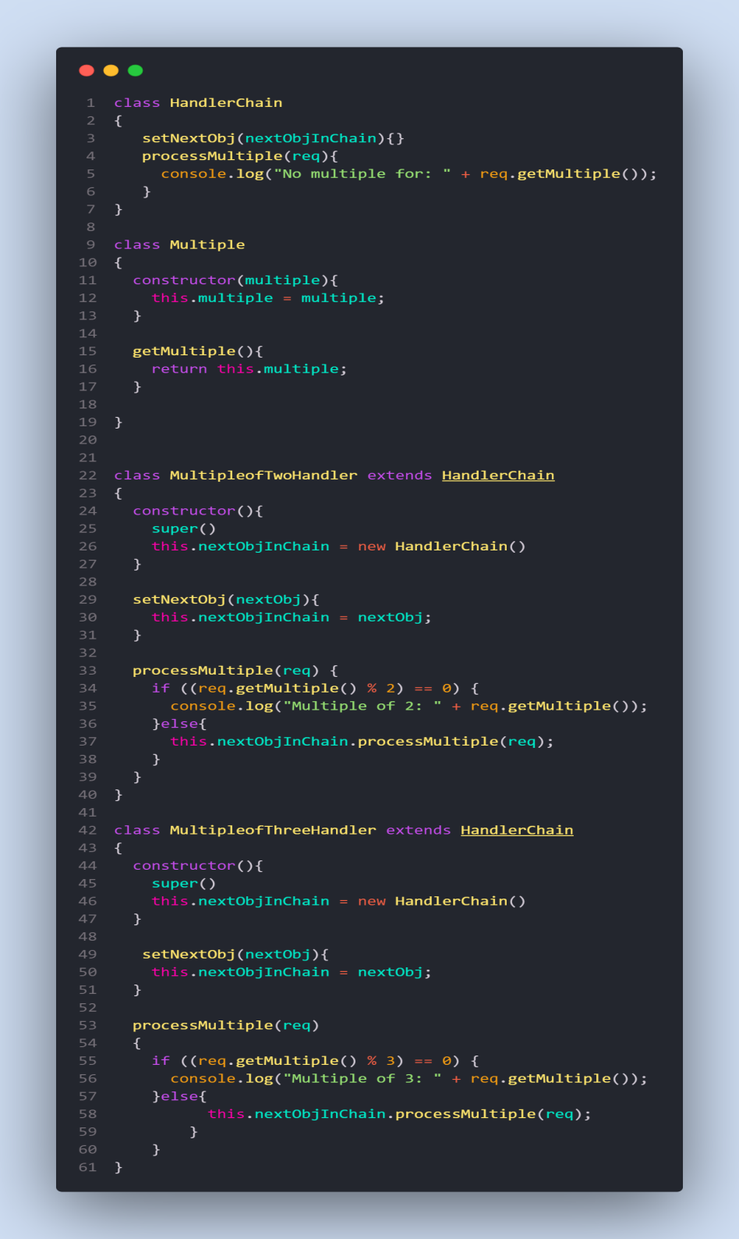
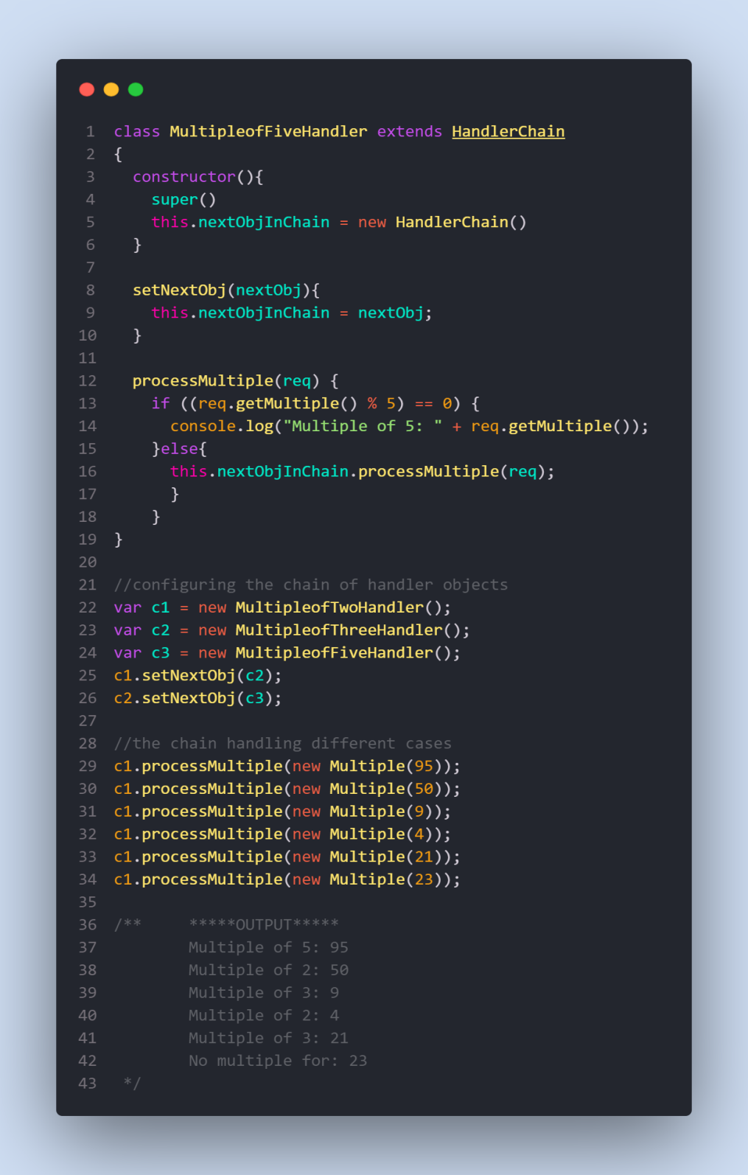

Slide 7
Useful Resources
https://refactoring.guru/design-patterns/chain-of-responsibility
https://www.educative.io/collection/page/5429798910296064/5725579815944192/5927001794805760
https://www.dofactory.com/javascript/design-patterns/chain-of-responsibility

